Slide 1

BC2410, Prescriptive Analytics From Data to Decisions
A Brief Review of Lecture 4

Slide 2
Assignment 1
1(a) (19)
3 (b) No figure
4 Proof no logic
5 (b) dimension for nutrient
6 Inventory does not carry over to next period; subscripts.

Slide 3
A Pottery Company’s Problem
Products: Bowls ($40) and Mugs ($50)
Please formulate this problem as a LOP and solve the problem graphically.
 | Bowl (B) | Mug (M) | Capacity
Labour | 1 | 2 | 40
Clay | 4 | 3 | 120

Slide 4
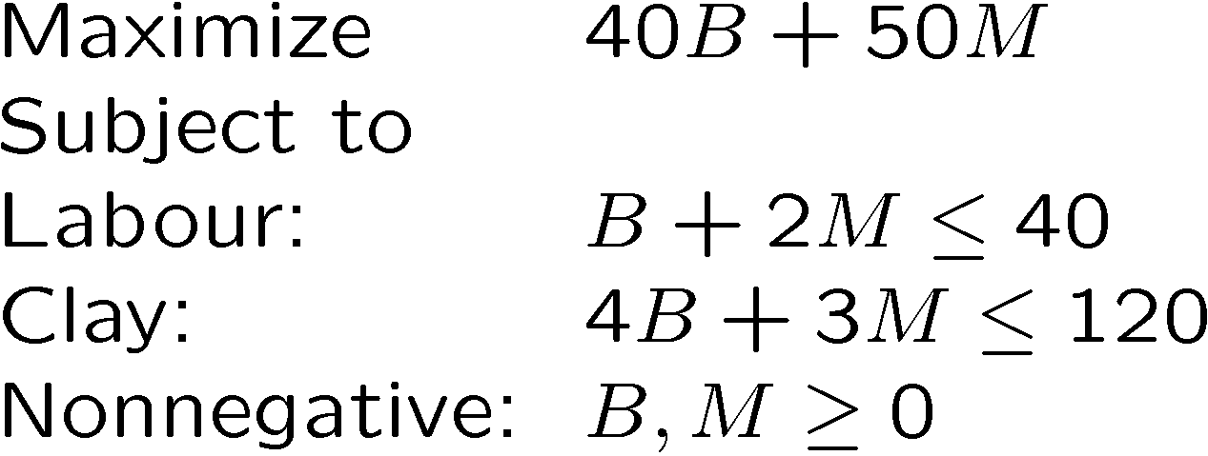
A Pottery Company’s Problem
Products: Bowls ($40) and Mugs ($50)
 | Bowl (B) | Mug (M) | Capacity
Labour | 1 | 2 | 40
Clay | 4 | 3 | 120

Slide 5
A Pottery Company’s Problem
M
40
max 40B + 50M
Which constraints are binding?
20
16
(24, 8)
0
20
30
40
B

